Slide 1
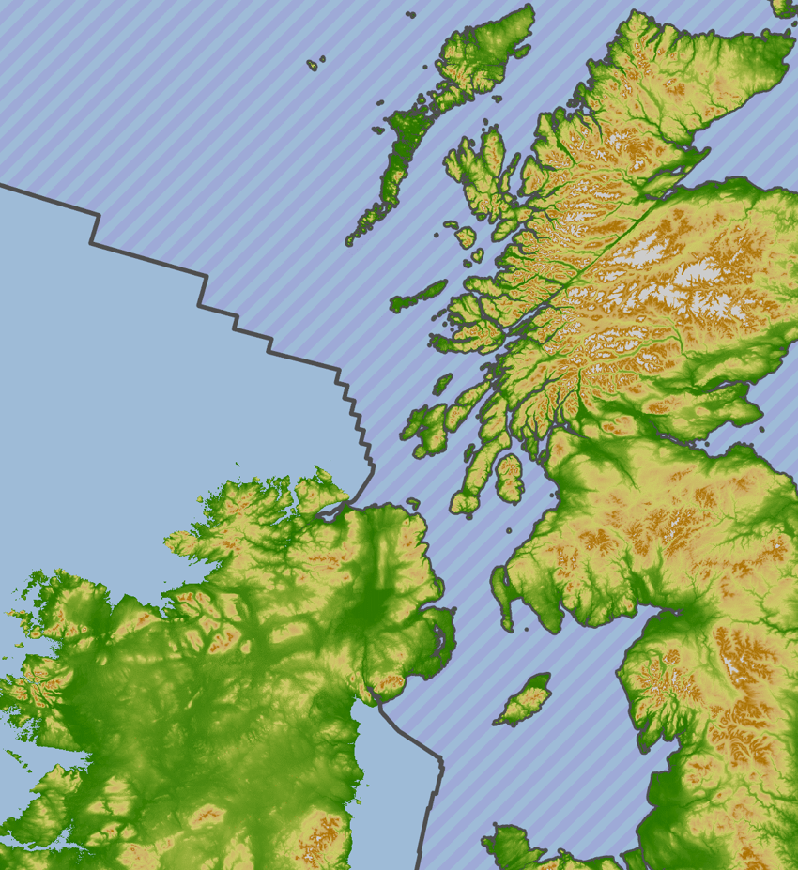
Finding Solutions for Surveilling our Seas with Multi-Criteria Decision Analysis
Vinnie Young, BAE Systems CORDA
Notes:
I’m Vinnie Young
We are CORDA
We’ve been assessing options for investment in technologies to improve the UK’s MDA

Slide 2
Key Take-aways:
Multi-criteria Decision Analysis (MCDA) is useful
Secondarily:
Maritime Domain Awareness (MDA) is interesting
We did a good job (but there’s always room for improvement)
Notes:
Lead with the takeaways

Slide 3
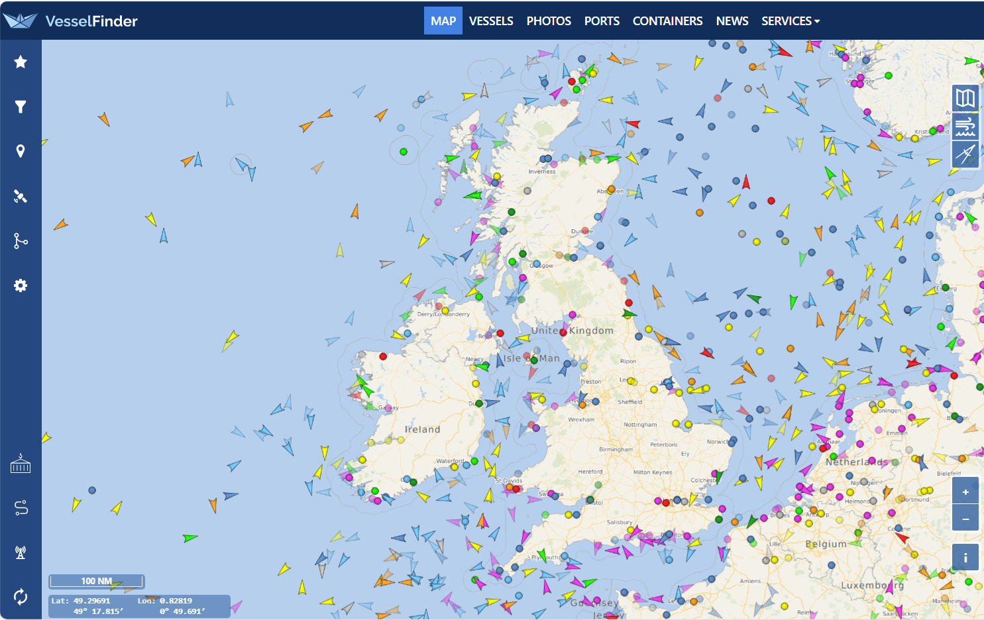
The problem:
Threats in our waters
“Cooperative” Vessels
Notes:
This is a map of known vessels
These vessels are sharing their location with us
Don’t worry about the colours and the dots
We know a number of characteristics about these vessels
Spoofing

Slide 4
The problem:
Threats in our waters
“Dark” Vessels (Indicative)
Notes:
Some vessels don’t share their location or their data
Some vessels are not required to share their location with us
We don’t have perfect awareness or data on these vessels
We may not even know that they are there

Slide 5


The problem:
Threats in our waters
Russian Warship
Threat Vessels (Indicative)
Disguised Fishing Vessel
Spy Ship
Terrorist
Notes:
These vessels are sometimes threats
We can gather the key data on “cooperative vessels” in the EEZ
We do not have the key data on all “dark vessels” in the EEZ
Of those dark vessels we know about, we don’t always know everything we want to
Without knowing more about the dark vessels that are out there, it’s difficult to spot suspicious behaviour

Slide 6
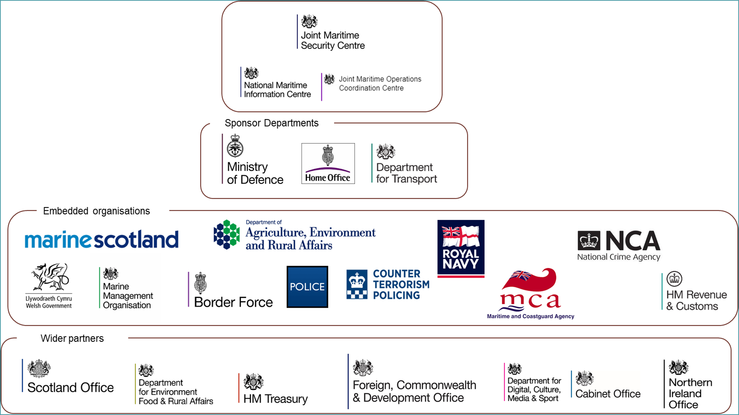
Who’s Interested?
Notes:
Who is concerned with this issue
JMSC

Slide 7


Who’s Interested?
Notes:
*Read the statement*

Slide 8

The Ask
To provide JMSC with an independent, professional assessment of what our Maritime Domain Awareness gaps are, and how best to fill them.
What makes up “Maritime Domain Awareness”?
How close to perfect MDA are we?
What are the best solutions?
What characteristics does a good solution have?
What solutions are there to choose from?
What does current MDA look like?
What does perfect MDA look like?
Notes:
“Understand the extent of the gaps in UK Maritime Domain Awareness (MDA)”
“Identify solutions to fill them”
“Conduct a cost-performance assessment of these solutions”
“And provide a roadmap to improve MDA”

Slide 9
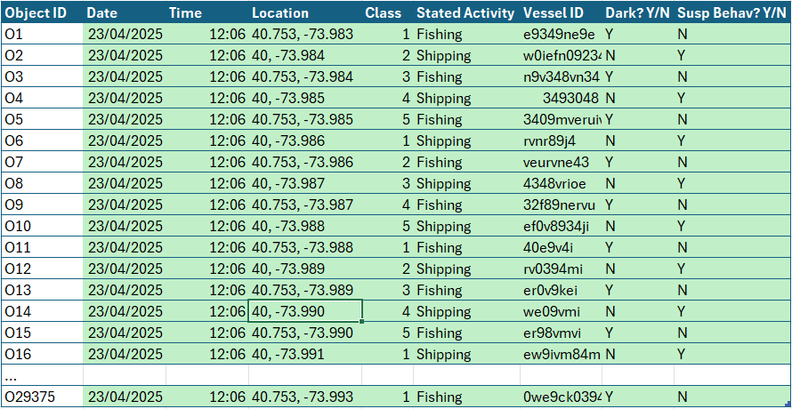
What does perfect MDA look like?
Indicative
Notes:
A different way to think about the problem if you are a data-driven problem
Explain the table “across the top”
Data on every vessel in the EEZ
Capturing all relevant data points for each vessel
For each data point to be “high quality” (recent, reliable, accurate etc.)

Slide 10
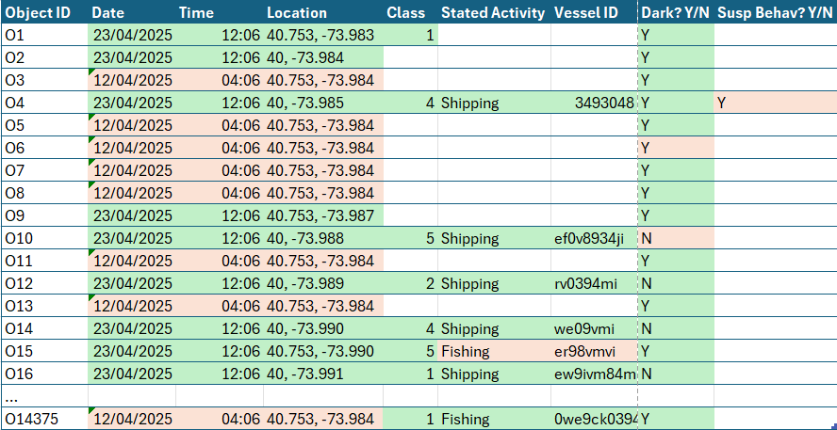
What does imperfect MDA look like?
Indicative
Notes:
For many vessels in the EEZ (especially dark), no data at all
For known vessels, no data on some characteristics
For known vessels, some data “low quality” (old, inaccurate, unreliable)
Our MDA is not perfect

Slide 11
The Ask
To provide JMSC with an independent, professional assessment of what our Maritime Domain Awareness gaps are, and how best to fill them.
What makes up “Maritime Domain Awareness”?
How close to perfect MDA are we?
What are the best solutions?
What characteristics does a good solution have?
What solutions are there to choose from?
What does current MDA look like?
What does perfect MDA look like?
Notes:
“Understand the extent of the gaps in UK Maritime Domain Awareness (MDA)”
“Identify solutions to fill them”
“Conduct a cost-performance assessment of these solutions”
“And provide a roadmap to improve MDA”

Slide 12
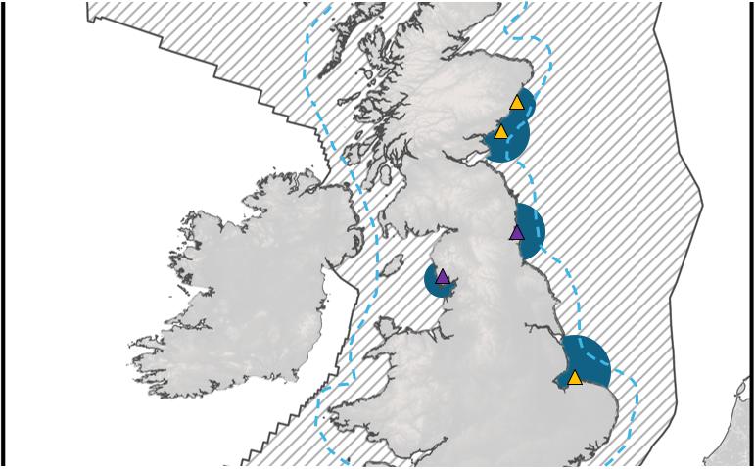
Understanding the “As-is”
Indicative “static coverage” Visualisation
Notes:
I hope you enjoyed that exploration of Maritime Domain Awareness as a concept
More to come
What we did
How it lead to Multi-Criteria Decision Analysis
Understand the surveillance assets JMSC has (or has access to data from)
Understand their position and range
Model in GIS software
Total Static Coverage = x%
The area with lines is part of the EEZ and the dotted line is the TTW

Slide 13
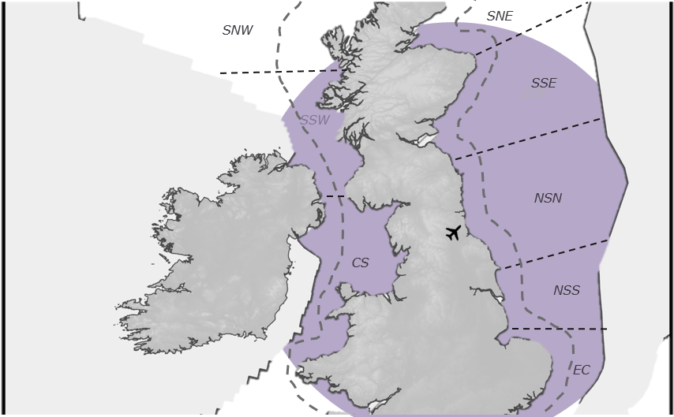
Understanding the “As-is”
Indicative “mobile coverage” Visualisation
Notes:
Understand the surveillance assets JMSC has (or has access to data from), and how much “effective mission time” they have
Understand the position of take-off locations and range
Calculate how much coverage per day mobile assets could get
Total Mobile Coverage per day = x%
On this map the different seas are labelled
Then we understood their As-Is

Slide 14
Creating a list of solutions
Longlisting
BAE SMEs
Project team SMEs
Literature Review
Previous CORDA work
Shortlisting
First-look Capability
First-look Readiness
First-look Viability
First-look Affordability
Notes:
In order to create a list of solutions
Longlisting
We didn’t have sufficient data to assess some solutions

Slide 15

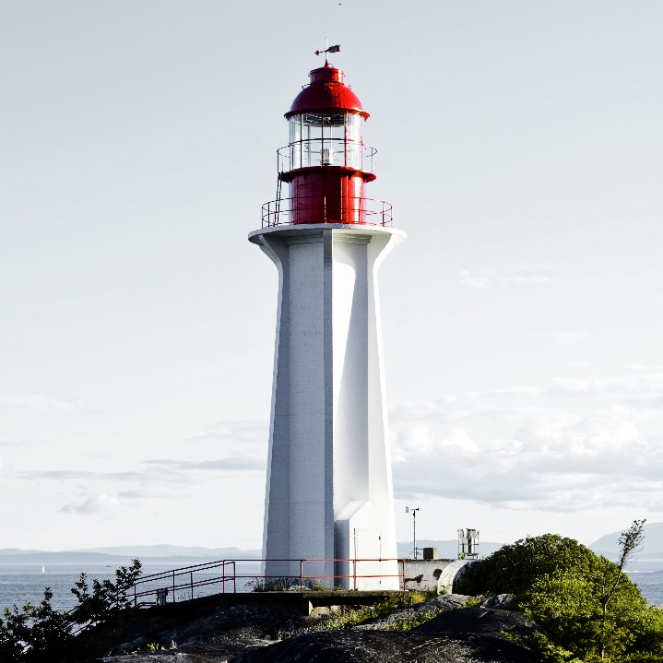
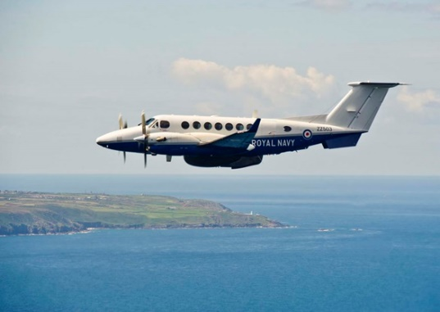

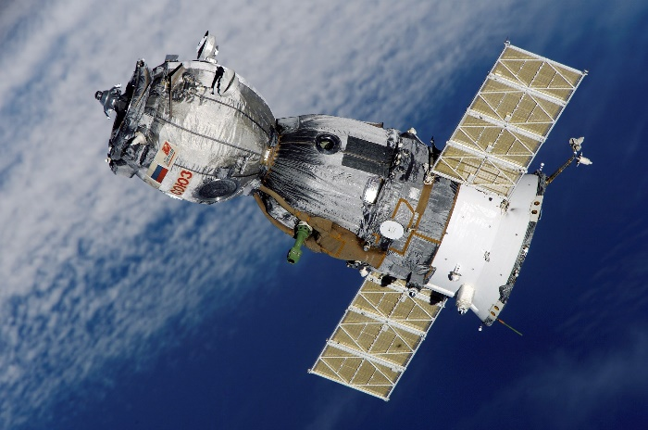
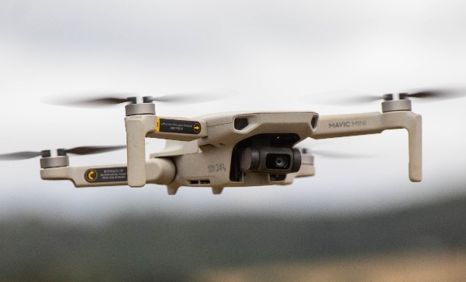
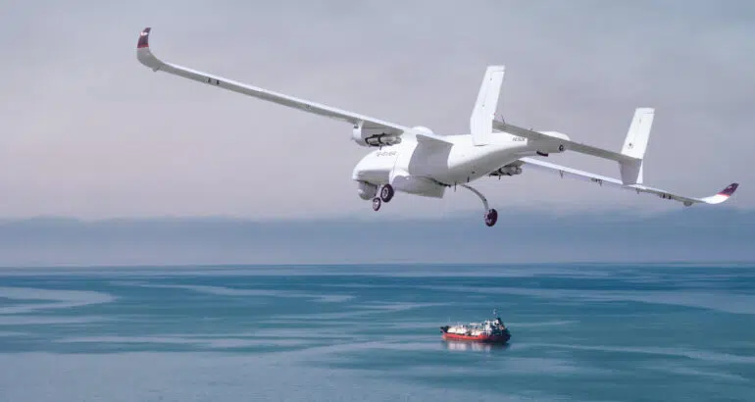
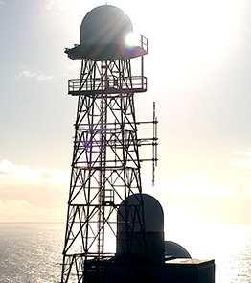
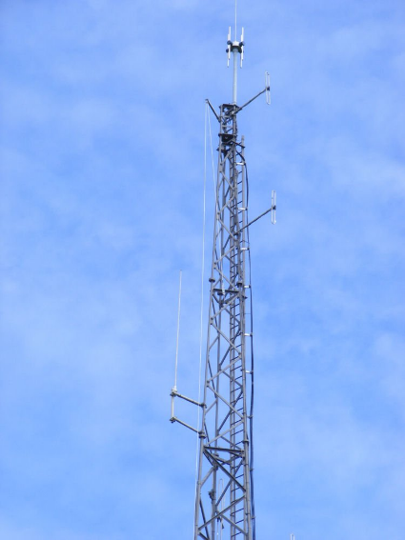
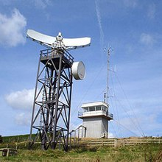
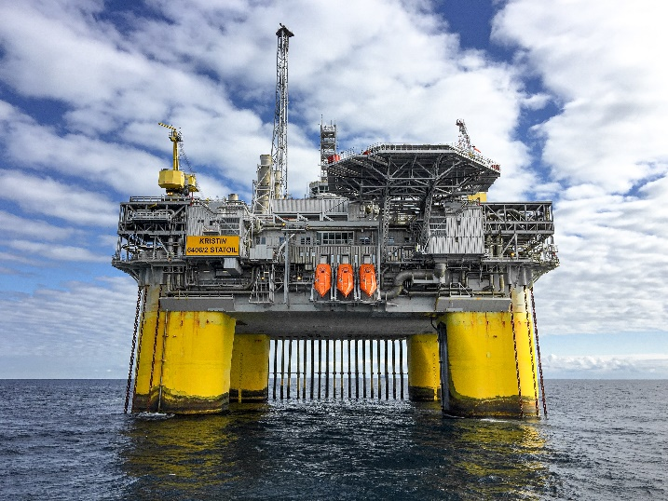
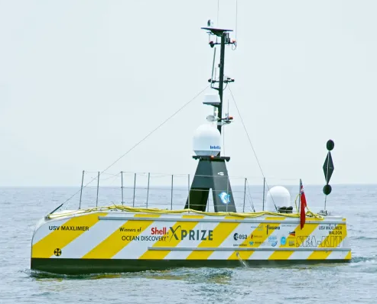

Creating a list of solutions
Notes:
Some solutions were expanding what JMSC already had access to
Radar, Land-based systems, mobile ground solutions
Others would be new to JMSC
Autonomous platforms, satellite
*Explain a couple in detail

Slide 16


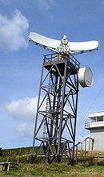
Business as Usual
Do Minimum
Do Maximum
Continue with the current assets (if any) and usages
Low level purchasing. Focusing only coverage of known hot spots
Gold plated layered solution with full coverage and persistence of the EEZ
Land-based Systems
Notes:
How did we make options for investment
Lets focus on Land-based systems

Slide 17
Do Minimum
Low level purchasing. Focusing only coverage of known hot spots
Land-based Systems
Type of platform: Radar tower
Amount of platforms: 15
Type of sensor: Solid State, pulse-doppler radar
Amount of sensors: 15
Location(s) of system(s): Location a, b, c, d, e, f…
* illustrative
Notes:
There’s more detail behind these options

Slide 18

Why Multi-Criteria Decision Analysis?
 | Opt1 | Opt2 | Op3 | Op4 | Op5 | Op6 | Op7 | Op8
Crit1
Crit2
Crit3
Crit4
Crit5
Crit6
Crit7
Best option!
Notes:
This is a super simple MCDA, ours is more complex

Slide 19
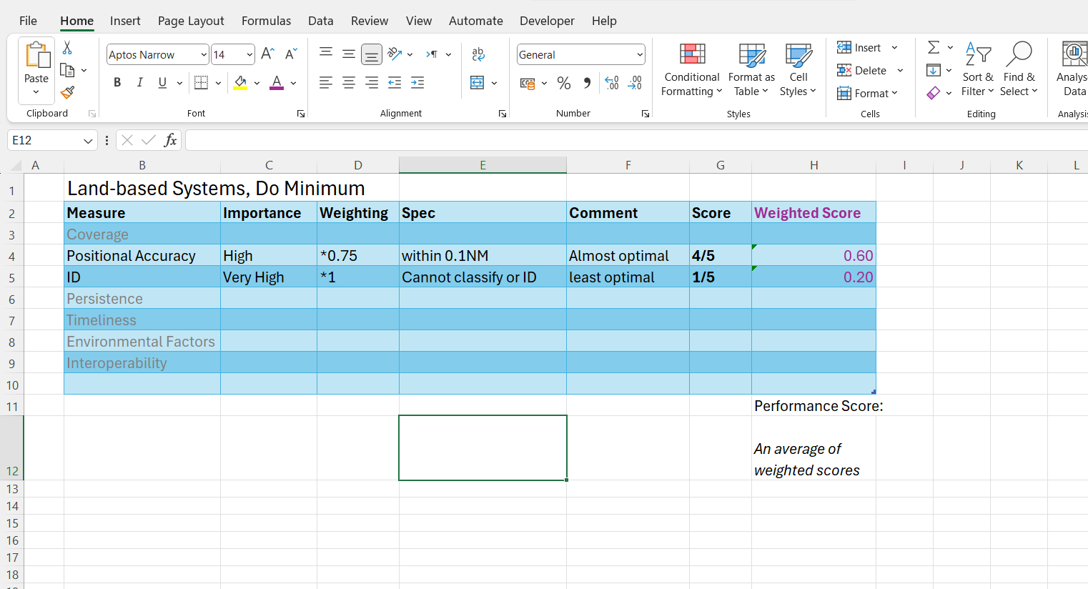

Notes:
This is how we assessed performance
What affects how good the technology is? What features do JMSC care about?
How important is each measure?
This applies a multiplier
What is the spec of the technologies involved in the option set?
A scoring system
Weighting * score = weighted score
AVG(weighted score) = Performance of option
Now we know which options had the highest performance

Slide 20
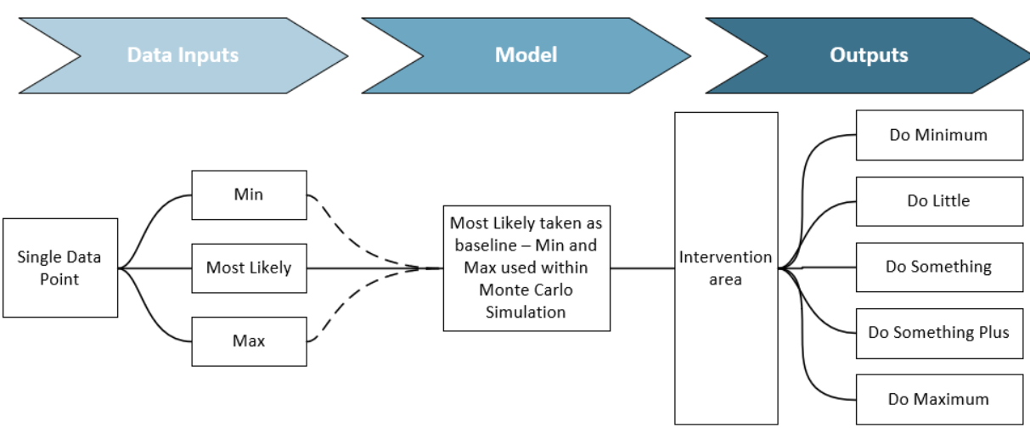
How much ‘Bang-for-buck’ does each Option have?
Notes:
We performed a cost analysis
Our colleagues in Techmodal did this bit
But the output was probable costs for each option

Slide 21
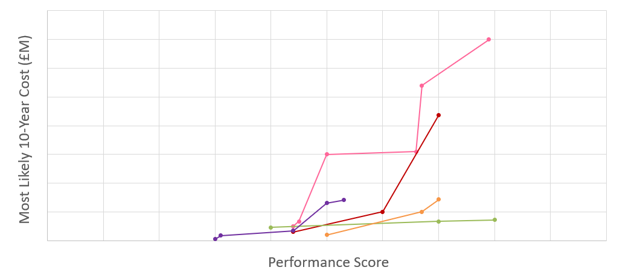
How much ‘Bang-for-buck’ does each Option have?
£x
Land-based Systems, Do Minimum
Average cost-performance
£0
0
100
Notes:
Cost-performance
*Explain the graph*
Line of best fit
Land-based systems, do minimum

Slide 22

How will each option “perform”?
Qualitative Analysis
Context – Not all “high-performing” options will perform well for this use-case
System of Systems – What does the option add to an already existing system?
Operational benefit – How would the asset / data actually be used? How does that affect the “performance” of the option?
Notes:
Adding our judgement to the MCDA

Slide 23
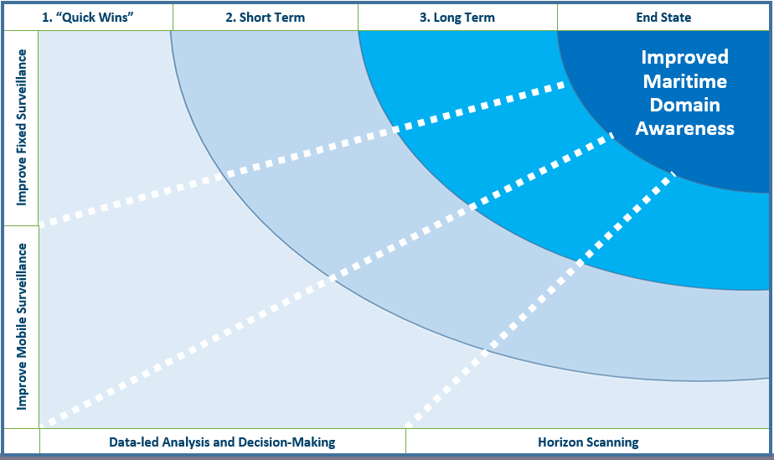
How should JMSC improve MDA?
Achieve (near) optimal investment
Invest in high-performing solutions
Exploit existing investments better
Notes:
MCDA helped us fill out this diagram with confidence
This is our roadmap structure

Slide 24
The Ask: part 2
“…develop Investment Appraisal evidence to support the writing of an outline business case for the purchase of
High-frequency Surface Wave Radar (HFSWR) capability”
Notes:
Our report was successful, JMSC came back for more
Assess HFSWR with other solutions
Borderforce saw our JMSC project and said, we want one

Slide 25

High-frequency Surface Wave Radar
Indicative*
Notes:
180NM

Slide 26
Outcomes
“An exceptional report and fully accepted by the team.
We will use the report to support our future procurement options, subject to funding.” – Michael Allen, PMO at JMSC

Slide 27
Key Take-aways:
Multi-criteria Decision Analysis (MCDA) is useful
Secondarily:
Maritime Domain Awareness (MDA) is interesting
We did a good job (but there’s always room for improvement)
Notes:
Lead with the takeaways

